Slide 1
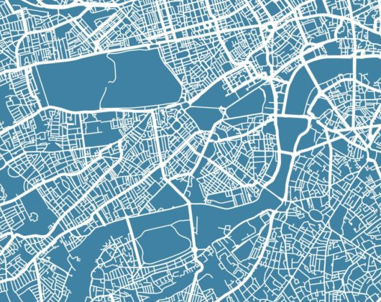
Geospatial 101
Doing stuff in python

Slide 2
Introduction to Geospatial Data
Projections
Vector Data
Raster Data

Slide 3
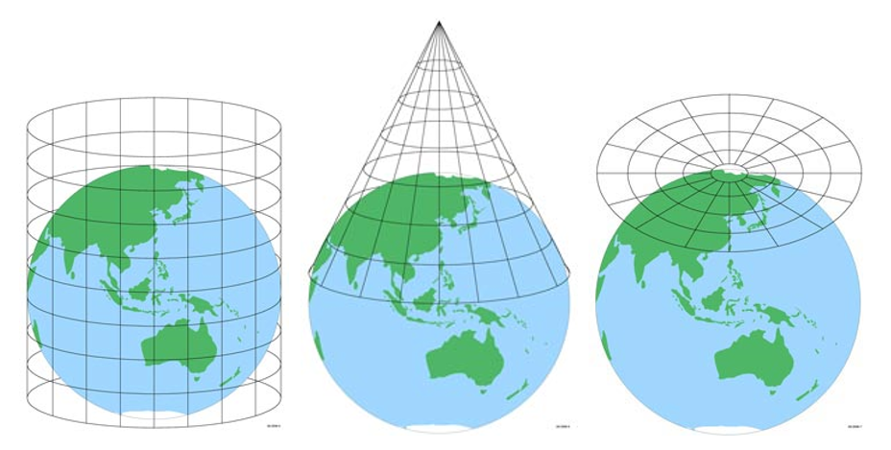
What are projections?
A projection is a method for representing the 3D surface of the earth on a 2D map.
Projections are a compromise, each one minimizes different types of distortion (distance, shape, area)
Different projections are used depending on the purpose of the map/analysis, and the accuracy required.

Slide 4
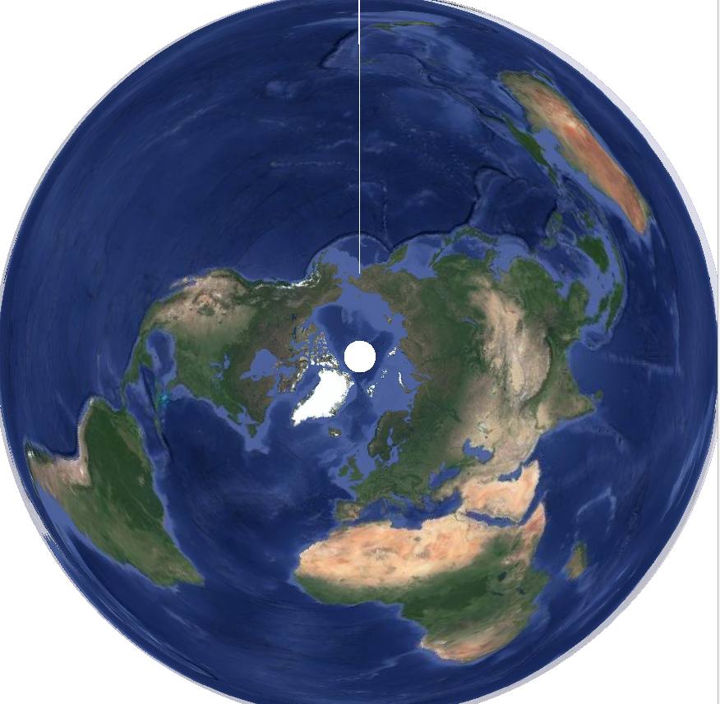
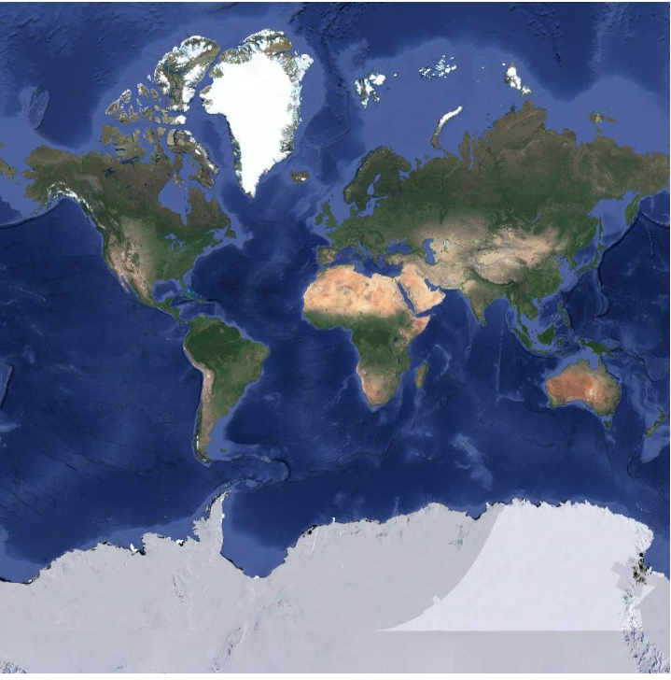
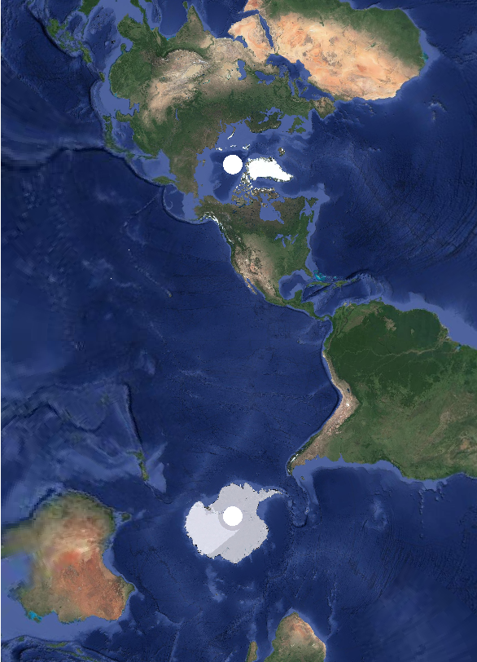
Different Projections
https://www.axismaps.com/guide/map-projections
WGS84 | Mercator
WGS84 | UTM 10 N
WGS84 | Lambert Azimuthal Equal Area

Slide 5
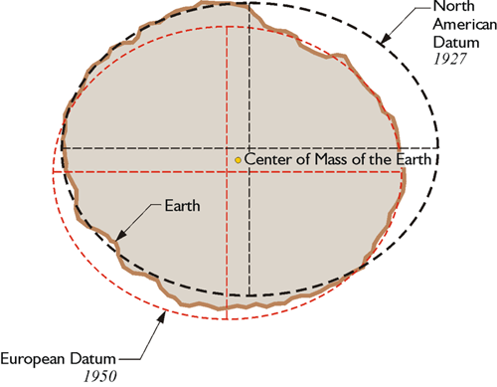
Datums: What’s the WGS84 thing?
Projections are a method for distorting the 3D earth into a 2D map. A datum is how we define the coordinate system. (I think kinda like choosing the best place to project from that minimizes error across the map)
Satellites and Surveyors go around and measure reference points on the earth and take into account the shape, tectonic movements, etc.
Different datums optimized for different regions.
WGS84 – global
NAD83 – North America
ETRF - Europe

Slide 6

How important is this?
Are you a surveyor?
Probably very
Otherwise
Probably not
It’s important to know it exists
Transform your dataset into the right projection system (CRS) and then forget about it
I just use NAD83 | UTM 10 N for here
(is that the right thing to do? I dunno, works for me)

Slide 7
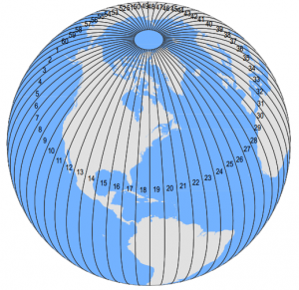
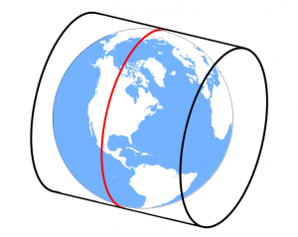
Common CRS (that I use)
Just remember these magic EPSG numbers and that’s all you’ll probably need
EPSG:4326
WGS84
Lots of datasets are often given in this
GPS coordinates
Units: Decimal Degrees
EPSG:26910
NAD83 | UTM zone 10
Good enough for measuring area and distance locally here
Units: meters
EPSG:3856
Web maps (OSM, google)
Basically same as 4326, but..
Units: meters
UTM splits the earth into 60 segments, then in half again for north and south. Then fits a cylinder to the earth as shown, and unwraps the 3D surface into a 2D plane.

Slide 8


Vector Data

Slide 9
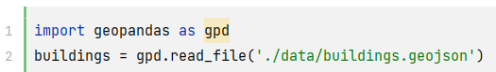
Opening Vector Data in Python
Vector File types
.shp Shape Files – ESRI ( ArcGIS )
.json GeoJSON - Web
.kml – KML - Google Earth
Etc. – Many others
Python geospatial libraries (e.g., GeoPandas, Shapely, Fiona)
Typically I just use GeoPandas

Slide 10
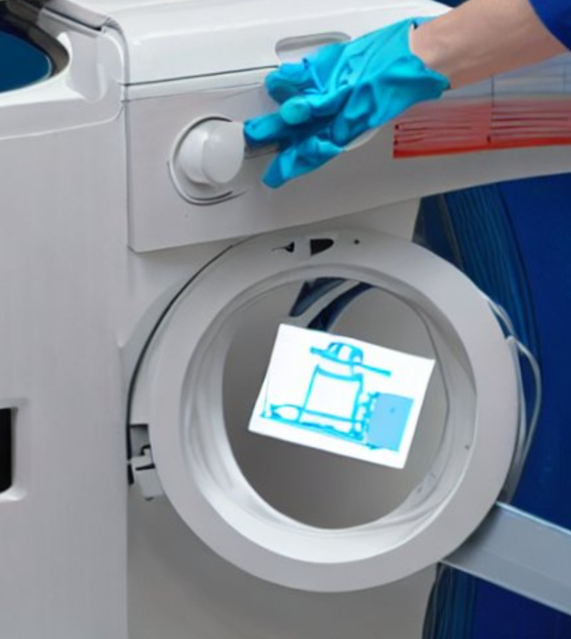
Data cleaning and preparation
Geospatial data often requires cleaning and preparation before analysis.
Common tasks include checking for missing or invalid data, transforming data to a common projection, and merging data from multiple sources.
This is like any other data source, and data processing step, nothing geospatial about it.

Slide 11
Manipulating geospatial data
Geospatial data manipulation involves tasks such as spatial joins, buffering, overlays, and clipping.
Spatial joins involve combining data based on their spatial relationships, such as points within polygons or polygons intersecting with other polygons.
Buffering involves creating a distance around a point or line to represent a certain area of interest.
Overlays involve merging or intersecting two or more datasets to create a new dataset.
Clipping involves extracting a portion of a dataset based on a specified area of interest.
GeoPandas can handle all these tasks.

Slide 12
Visualizing geospatial data
If it’s just for your own use:
Just load it into QGIS, way easier
If you need to make pretty interactive maps for stakeholders:
You can use libraries like Bokeh, and Altair for static maps, and Folium to create interactive maps.
Visualizing geospatial data can help reveal patterns, trends, and relationships that may not be apparent in tabular data.

Slide 13

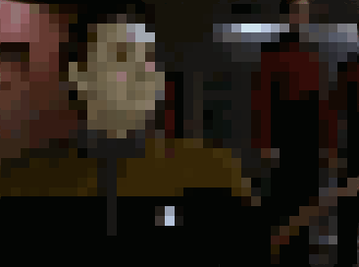
Raster Data

Slide 14
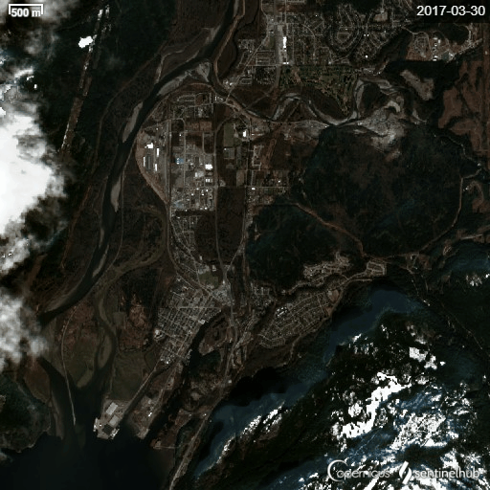
Rasters are just Images
Contain meta data
it stores the CRS the image is using, and the coordinates of the image in that reference frame.
Can Contain many color channels
Not just Red, Green, Blue
Near Infrared, Short Wave Infrared, Ultra blue
https://gisgeography.com/sentinel-2-bands-combinations/

Slide 15
How to analyse Rasters
Use Computer Vision
That’s beyond the scope of this talk though!
Then when you have detected stuff in the image, use the metadata in the image to convert the detected thing from image coordinates to earth coordinates

Slide 16
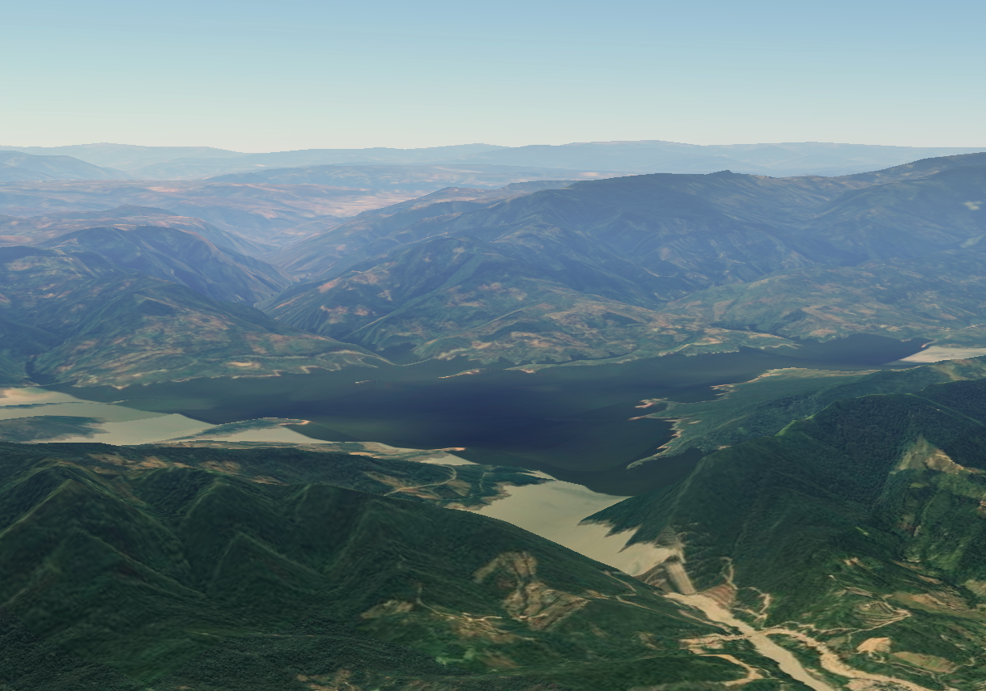
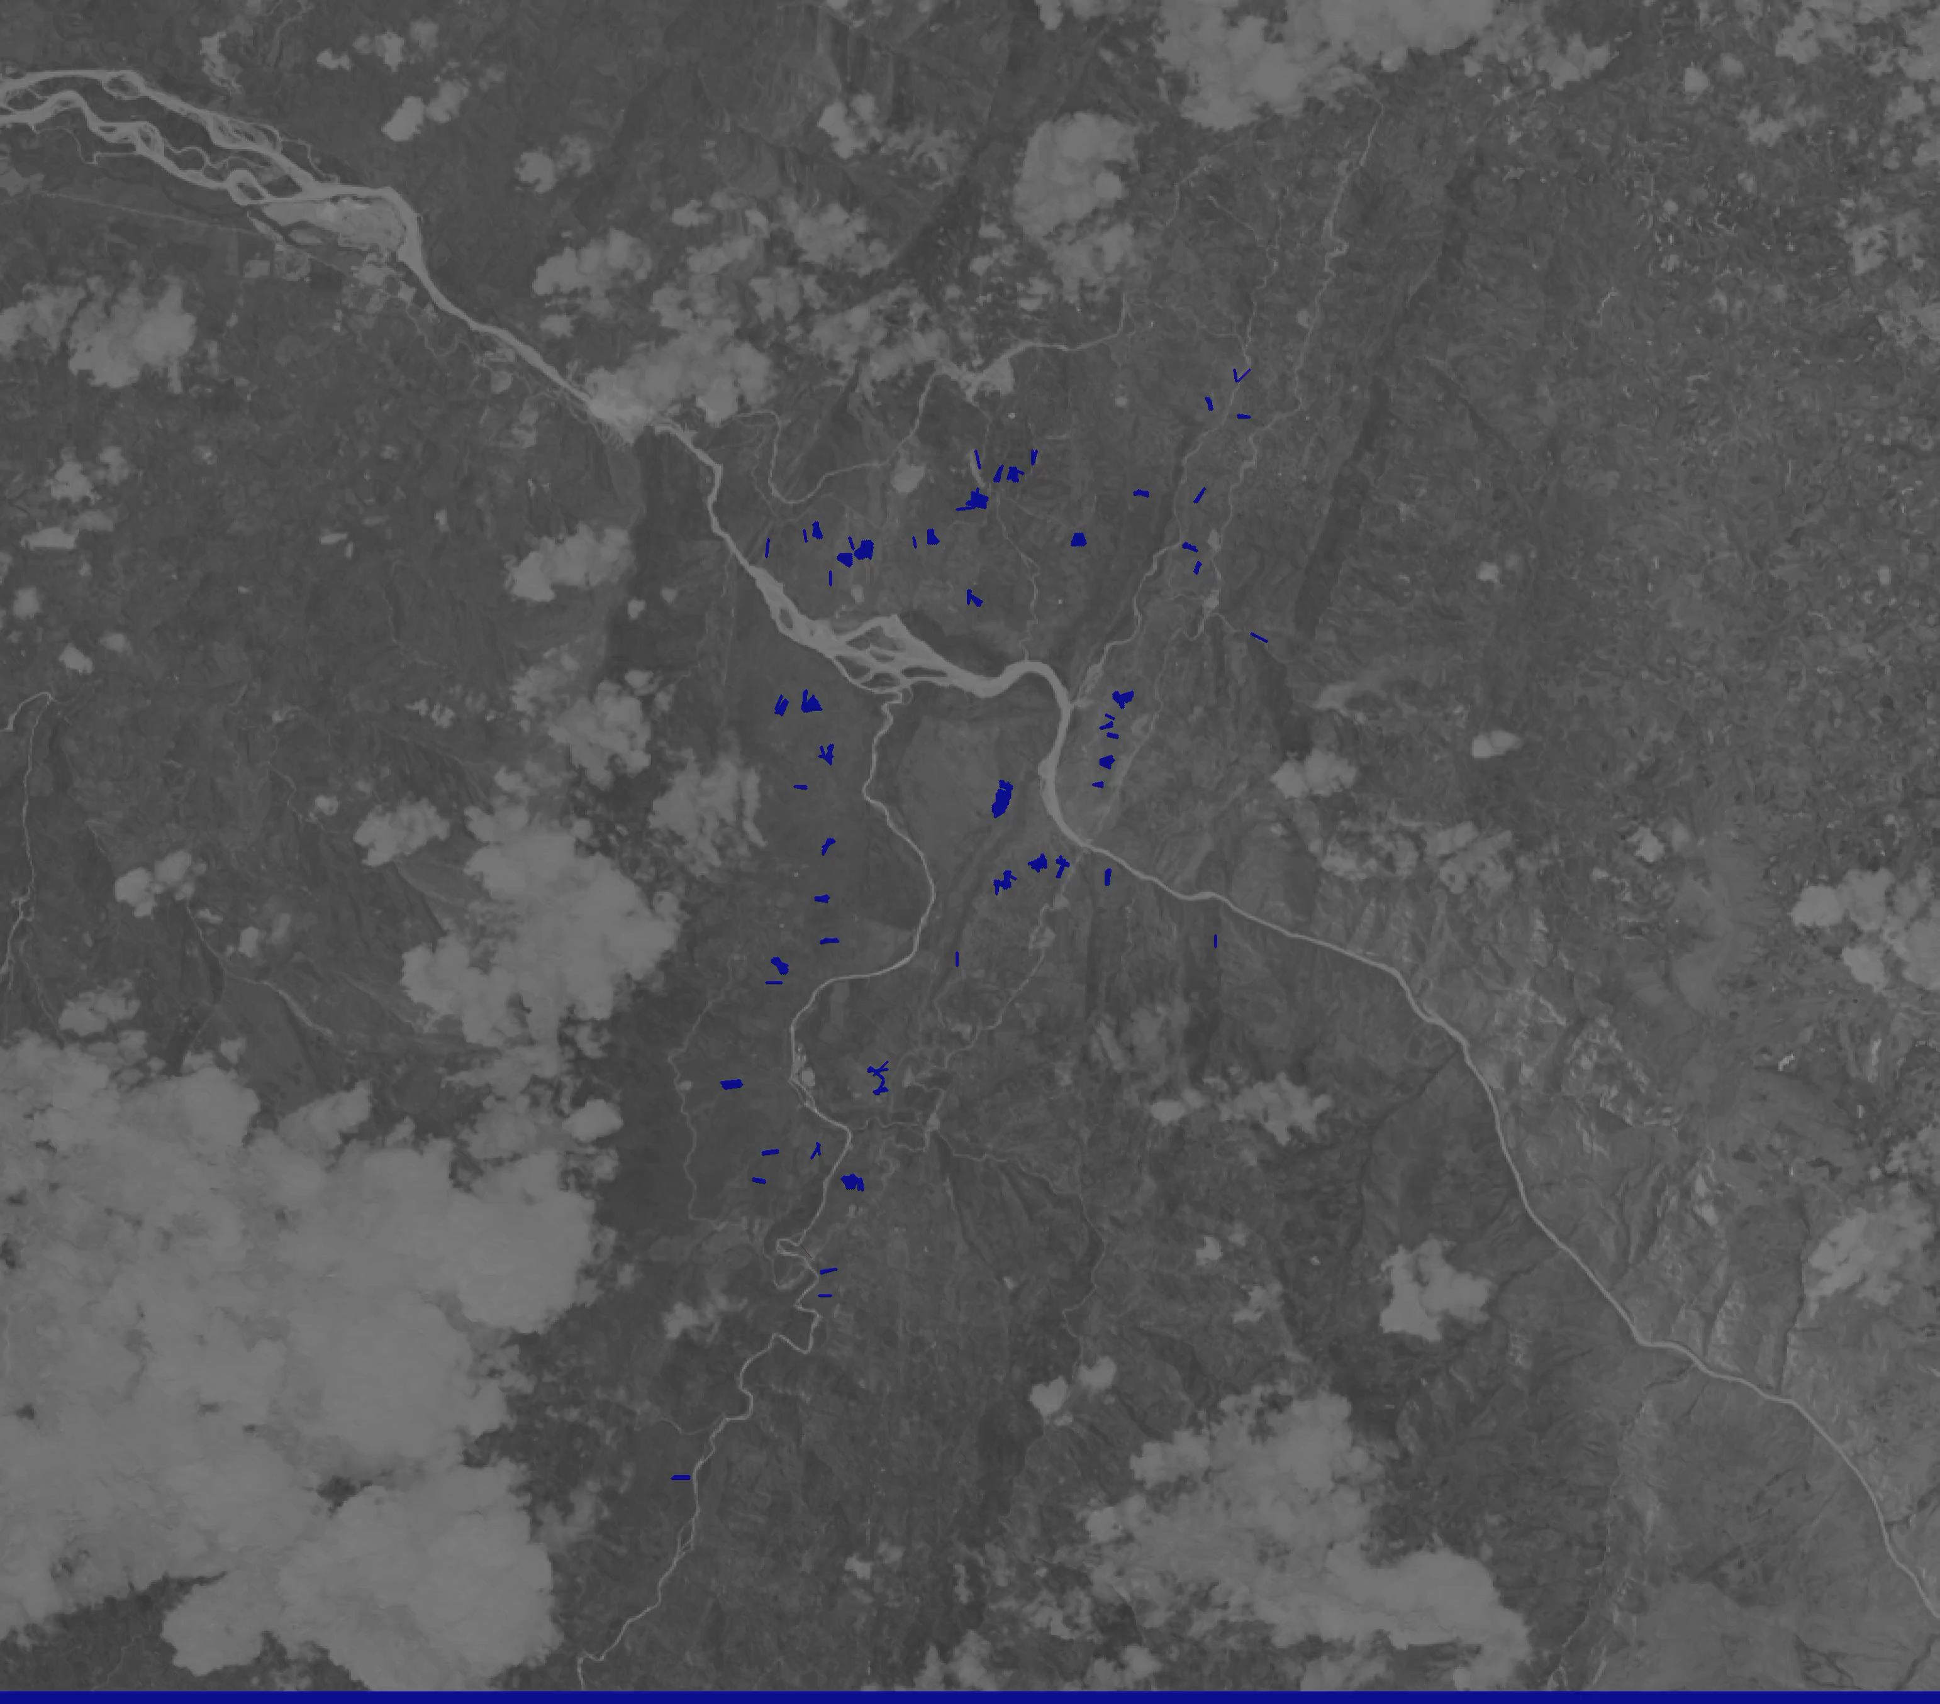
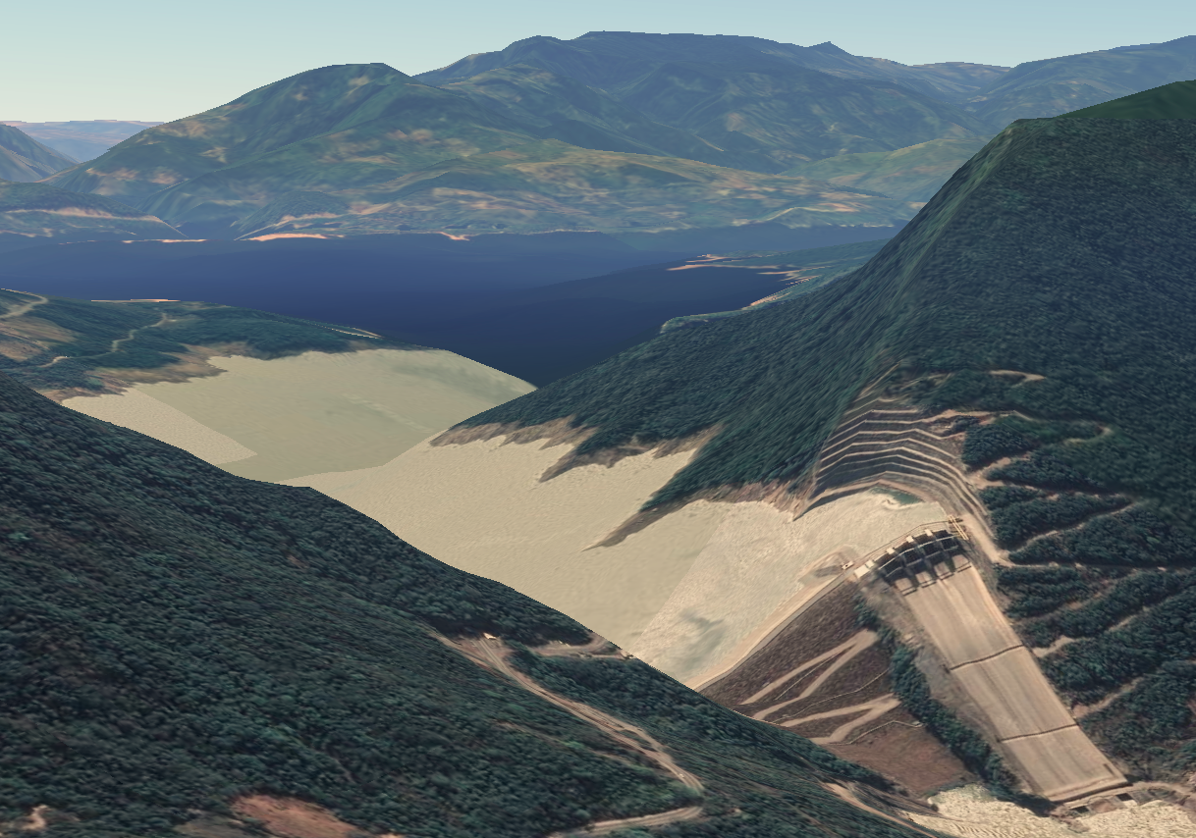
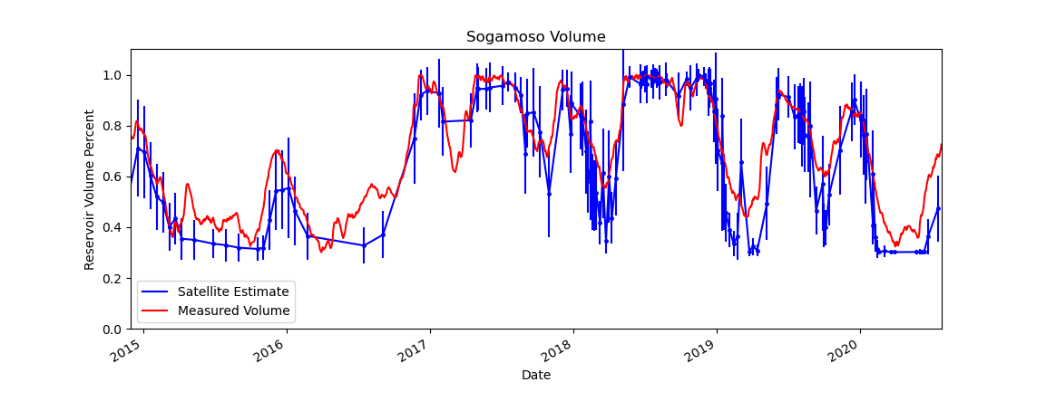
NDWI for reservoir monitoring

Slide 17
